Slide 1



Slide 2
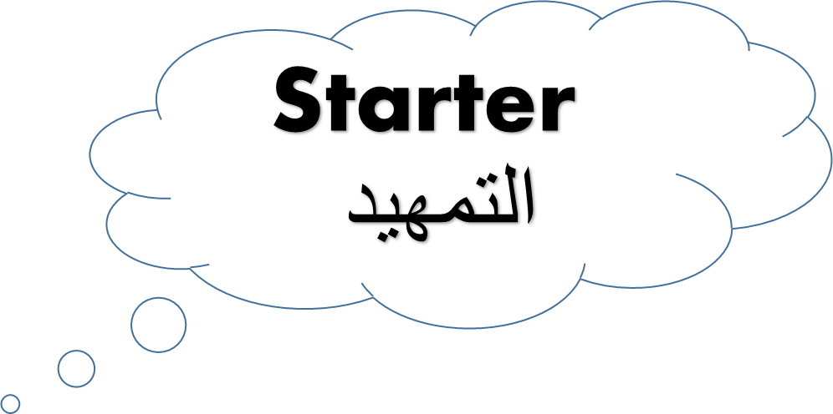
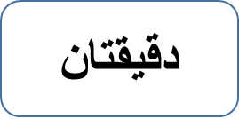
Matching
https://quizlet.com/426667486/match

Slide 3

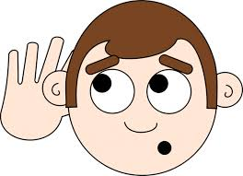
https://drive.google.com/open?id=1_7IpqU137yZY1sZ5esvNfG_Yyh78oxBK

Slide 4
-
-رتب أحداث القصة.
Sort story events

Slide 5
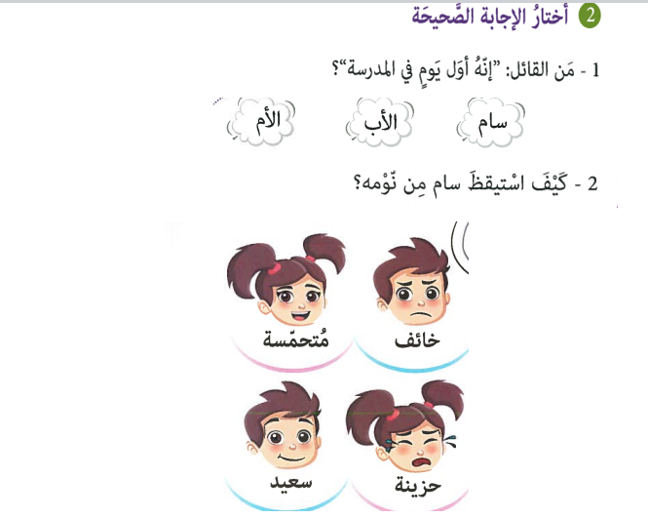

Slide 6
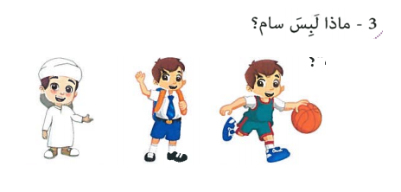

Slide 7
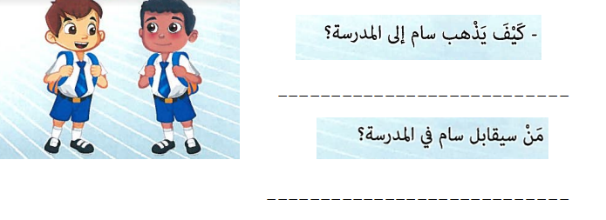

Slide 8
